Slide 2
The Distance-Vector (DV) Routing Algorithm
The distancevector (DV) algorithm is iterative, asynchronous, and distributed.
It is distributed in that each node receives some information from one or more of its directly attached neighbors, performs a calculation, and then distributes the results of its calculation back to its neighbors.
It is iterative in that this process continues on until no more information is exchanged between neighbors.
The algorithm is asynchronous in that it does not require all of the nodes to operate.

Slide 3
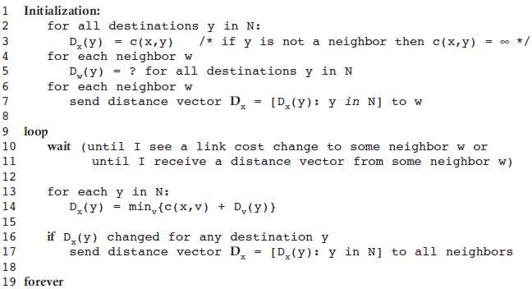

Slide 4
In the DV algorithm, a node x updates its distance-vector estimate when it either sees a cost change in one of its directly attached links or receives a distancevector update from some neighbor.
the only information a node will have is the costs of the links to its directly attached neighbors and information it receives from these neighbors.
Each node waits for an update from any neighbor calculates its new distance vector when receiving an update and distributes its new distance vector to its neighbors .
DV-like algorithms are used in many routing protocols in practice, including the Internet’s RIP and BGP, ISO IDRP, Novell IPX, and the original ARPAnet.

Slide 5
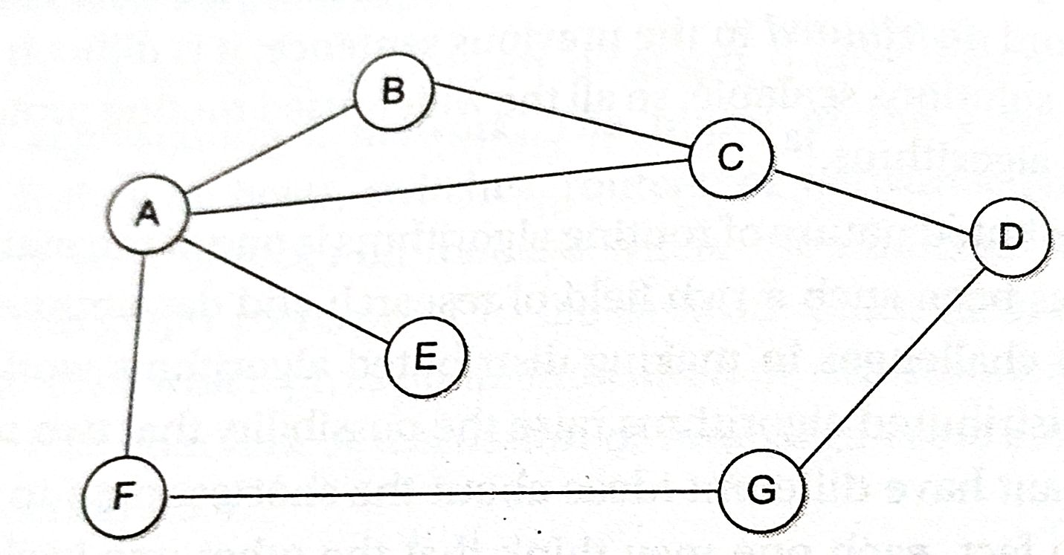

Slide 6
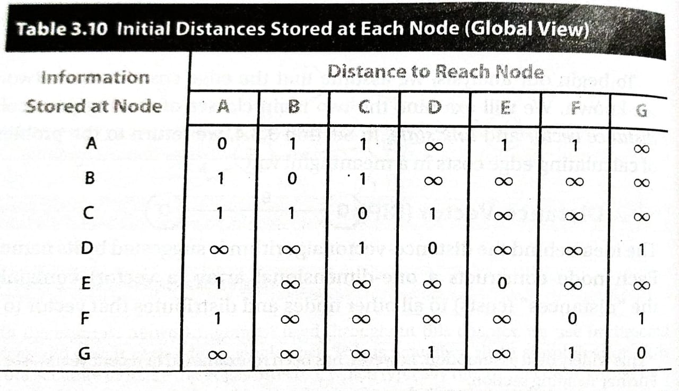

Slide 7
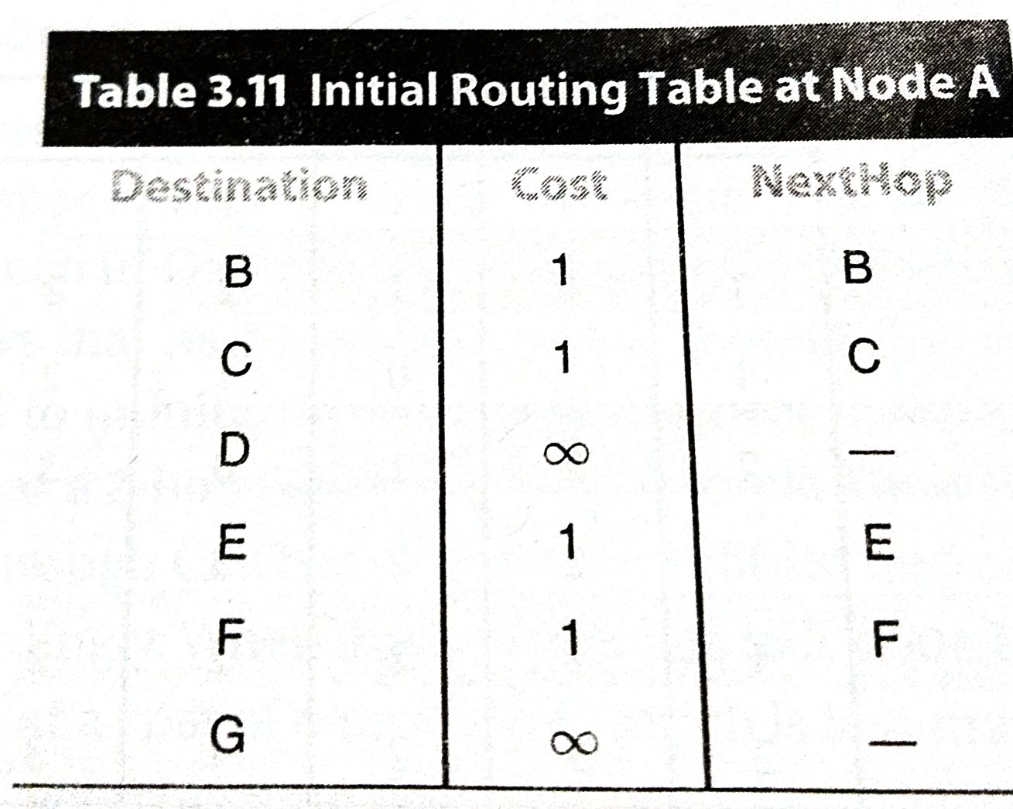

Slide 8
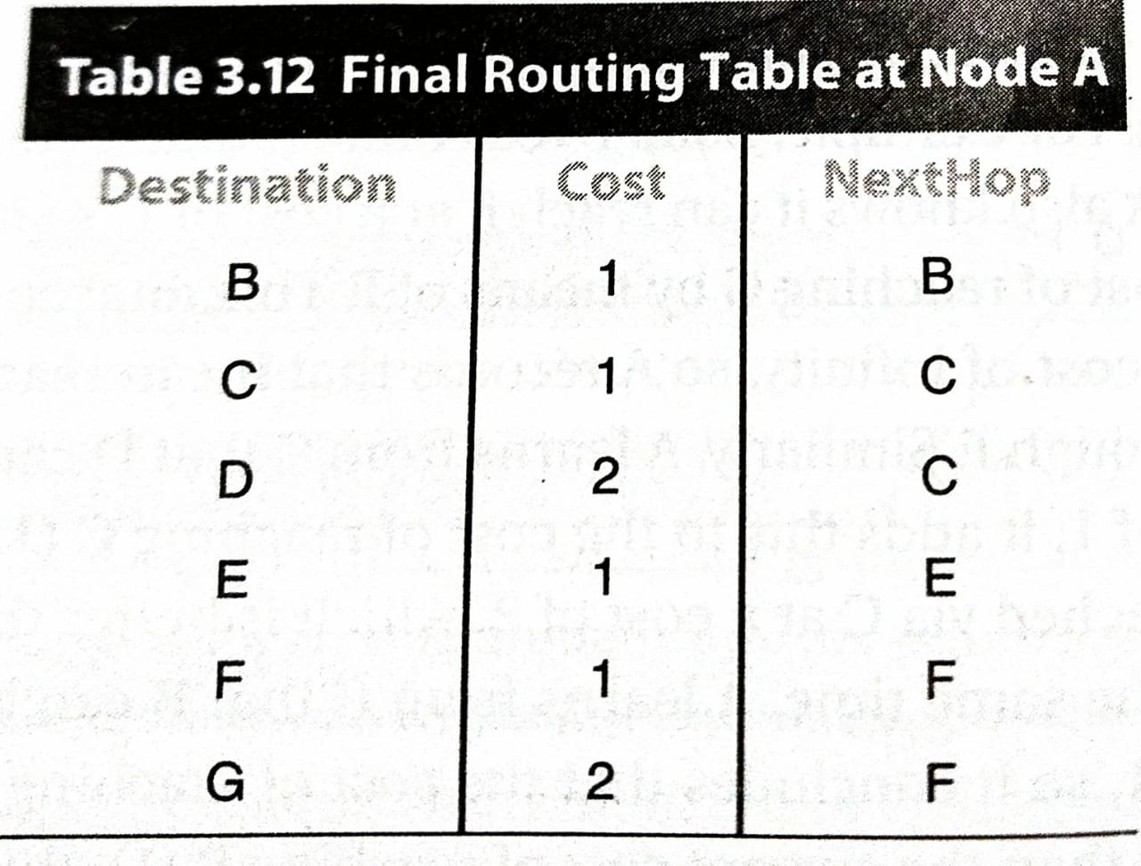

Slide 9
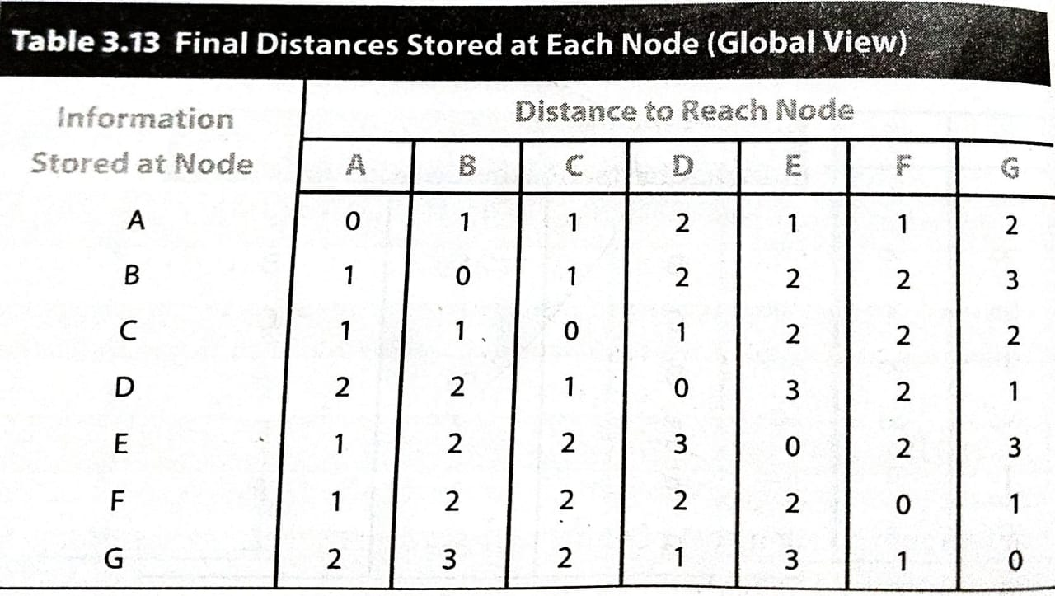

Slide 10
Convergence: Process of getting consistent routing information to all the nodes.
Node gives routing update under 2 circumstances:
Periodic Update
Triggered Update due to link failure or when a node receives update from one of its neighbors.
How to detect node failure?
Send a control packet and wait for acknowledgement
If periodic update is not received for the last few update cycles.
Drawback
Count to infinity problem
Solution
Split Horizon
Split Horizon with poison reverse

